Slide 1
State of Home Automation
2017Jun16

Slide 2
Contents
What do we mean by Home Automation?
Technologies / Protocols
Systems
Open Systems
Further applications

Slide 3
What do we mean by Home Automation?
Remote Control
Programmed Timers
Autonomous Operation

Slide 4
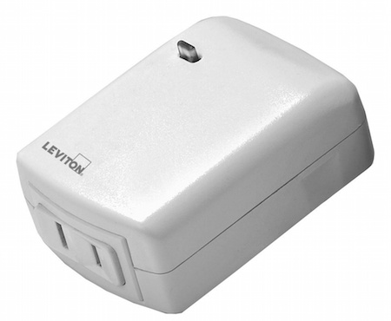
What do we mean by... : Remote Control
Remote control of lights and devices
On/Off
Dim levels
Generally includes a central controller.
Gives access to smartphones/tablets.
Voice Control has arrived.
Notes:
Leviton Plug-in Lamp Dimmer Module
Uses Zwave, connects to SmartThings Hub.
https://support.smartthings.com/hc/ko/articles/206174033-Leviton-DZPD3-Plug-in-Lamp-Dimmer-Module

Slide 5
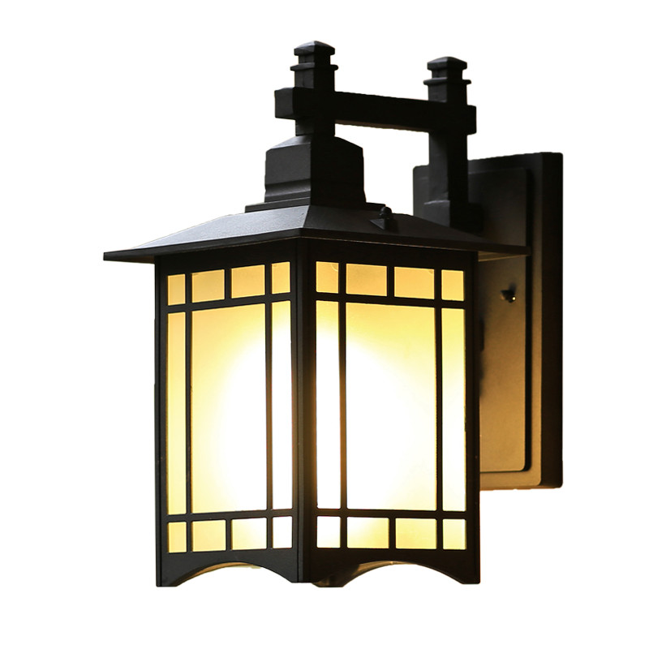
What do we mean by... : Programmed Timers
Do X at set time of day.
E.g. turn on porch light in evening
Notes:
https://www.aliexpress.com/w/wholesale-outdoor-porch-lights.html

Slide 6
What do we mean by... : Autonomous Operation
Grouping:
i.e. all room lights group to create scenes
E.g. dim mode with all lights set to 30%
Application of logic:
Don’t turn on coffee machine if no one’s home.
IFTTT
Sensors that control lights based on occupancy or movement.

Slide 7
Technologies / Protocols
X10
Insteon
Z-Wave
Zigbee
WiFi
UPB
- Large install base but outdated, unreliable
- Reliable, X10 Compatible
- Wireless (no powerline). Proprietary with large consortium of companies
- Wireless (no powerline). Open standard
- Standalone devices
- Improvement on X10, powerline only.

Slide 8
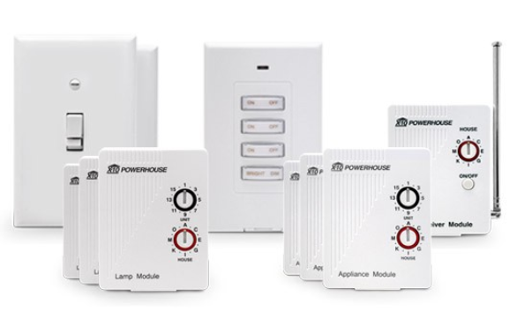
Technology: X10 (1990s)
In the 1990s we had: X10:

Slide 9
Technology : X10
X10 Technical Details
Many issues!
Powerline (uses existing house wiring)
No acknowledgement. Commands sent 3 times in hopes of successful reception.
Works on one side of power grid.
Tech details of pulses sent in 60 Hz. (TODO show pic?)
RF for wireless remotes
Connect to transceiver - still requires powerline!
Double chance of failure!

Slide 10
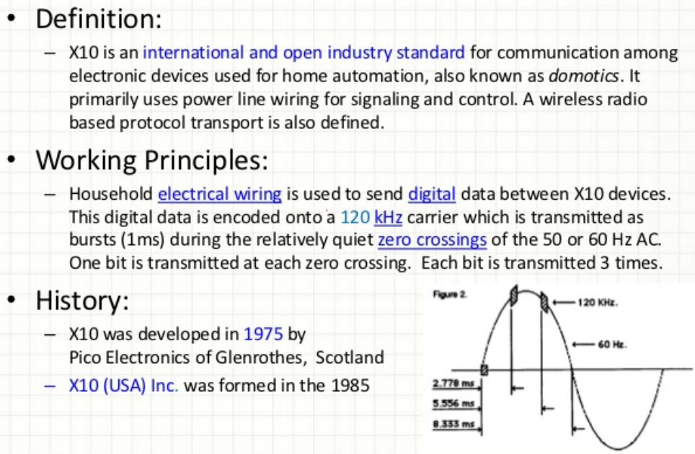
Technology : X10
Source: George Wang, 2012, http://www.slideshare.net/chowfei/smart-home-tech-short
Notes:
Snip from: Source: George Wang, 2012, http://www.slideshare.net/chowfei/smart-home-tech-short

Slide 11
Technology : X10
X10 Summary
Despite issues still has large existing user base.
Only for failure tolerant applications
May turn on by itself.
May not work all the time.
Inexpensive but not suitable for new users/installs.

Slide 12
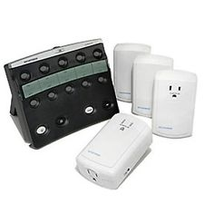
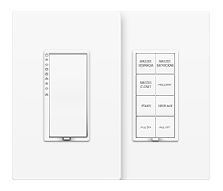
Technology : Insteon
By around 2005, Insteon provided a compatible and much better alternative:

Slide 13
Technology : Insteon
Improvements over X10
Devices are called Dual Band meaning signal can travel over both powerline and RF to ensure reception occurs.
All devices act as repeaters
Proprietary protocol so only one manufacturer
Group addressing allow simultaneous control of multiple devices.
Much more flexible than X10 All On/Off via House ID.
Notes:
DualBand / Hybrid of wireless/powerline from: https://turbofuture.com/computers/An-Introduction-to-Insteon-Home-Automation

Slide 14
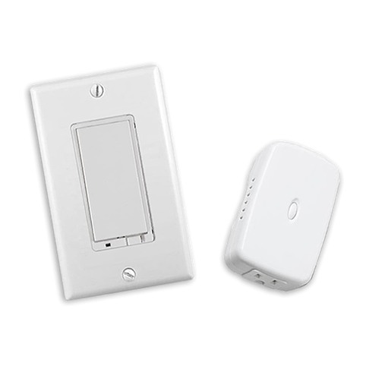
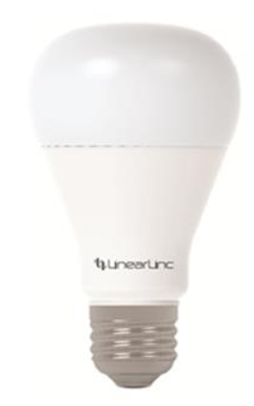
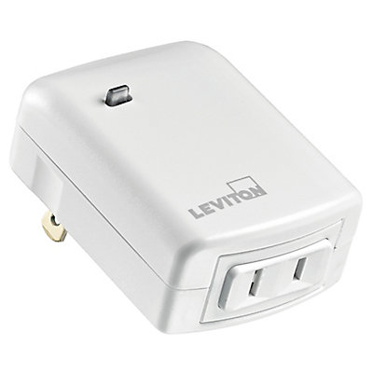
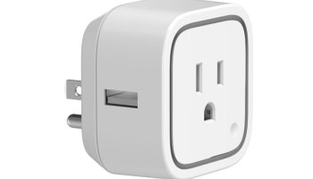
Technology : Z-Wave
Also around 2005, Z-Wave:
Notes:
Leviton, GE Plugs shown

Slide 15
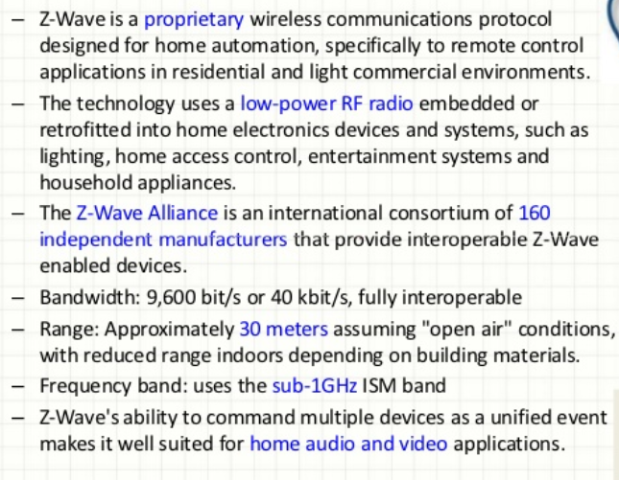
Technology : Z-Wave
Source: George Wang, 2012, http://www.slideshare.net/chowfei/smart-home-tech-short
Notes:
DualBand / Hybrid of wireless/powerline from: https://turbofuture.com/computers/An-Introduction-to-Insteon-Home-Automation

Slide 16
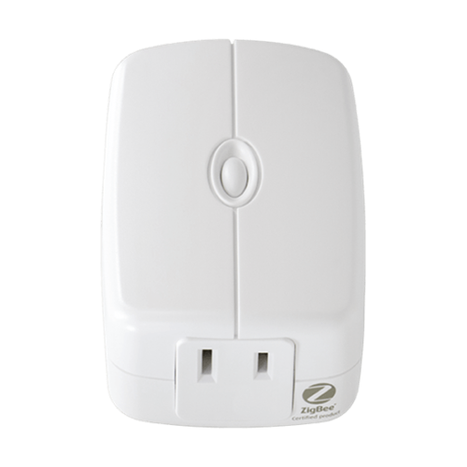
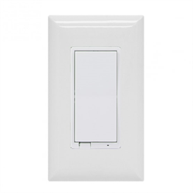
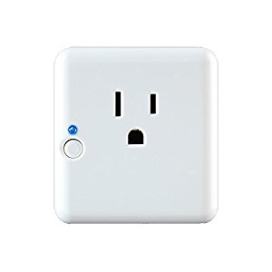
Technology : Zigbee
Zigbee IEEE specification standardized in 2003 and revised in 2006
Notes:
Centralite 3-Series ZigBee Plug-in Lamp
45852GE Zigbee Plug in Smart Dimmer
GE Zigbee In Wall Dimmer for Incandescent, CFL, LED Lights

Slide 17
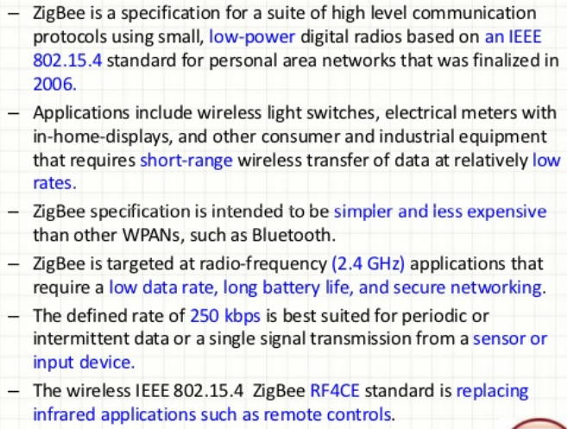
Technology : Zigbee
Source: George Wang, 2012, http://www.slideshare.net/chowfei/smart-home-tech-short
Notes:
DualBand / Hybrid of wireless/powerline from: https://turbofuture.com/computers/An-Introduction-to-Insteon-Home-Automation

Slide 18
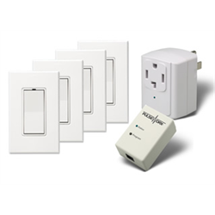
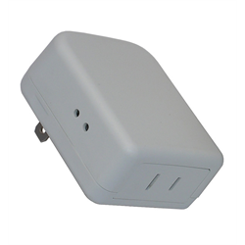
Technology : UPB
Released in 1999 UPB - Universal Powerline Bus:
Notes:
Centralite 3-Series ZigBee Plug-in Lamp
45852GE Zigbee Plug in Smart Dimmer
GE Zigbee In Wall Dimmer for Incandescent, CFL, LED Lights

Slide 19
Technology : UPB
UPB uses power line wiring for signalling and control.
Developed by Powerline Control Systems (PCS) of Northridge, California and released in 1999.
Claim of 100 ~ 1000 times more reliability X10.
Pulses on the powerline: ~40 volts;
More than five times greater than the 5 to 7 volt signals of X10.
Notes:
http://www.smarthome.com/sc-what-is-upb-home-automation
http://simply-automated.com/blog/2014/09/home-automation-systems-review/
http://www.simply-automated.com

Slide 20
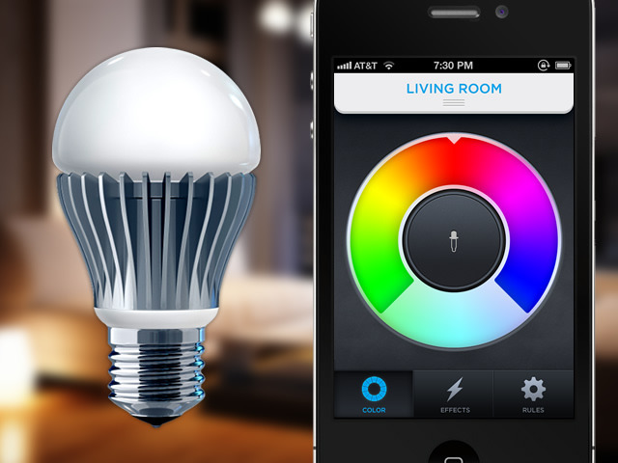
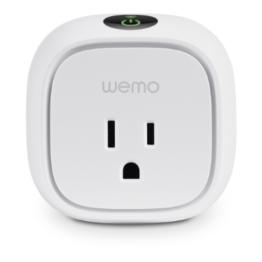
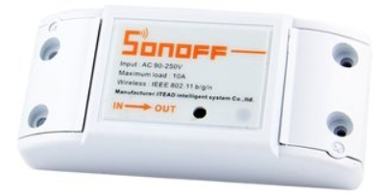
Technology : WiFi
Notes:
Wifi Light Bulb Philips

Slide 21
Technology : WiFi
May be closed system with vender specific app, or,
Hubs may integrate.
Concerns:
WiFi router becomes point of failure.
What happens when WiFi router/password changes, or when houses are sold?
Will we have to reconfigure many devices just to turn on the lights?
What is the user experience with WiFi?
Notes:
DualBand / Hybrid of wireless/powerline from: https://turbofuture.com/computers/An-Introduction-to-Insteon-Home-Automation

Slide 22
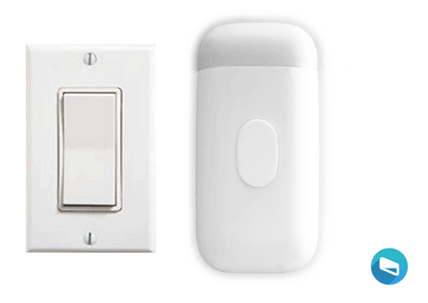
Technology: WiFi - Snap On
FlipMate
- https://flipmate.co/

Slide 23
Technology Degress of Failure
Insteon doesn’t require controller for basic operation. Dual band doubles reliability.
Zigbee/Z-Wave controller failure halts operation? Even from light switches?
WiFi outage affects smartphone control and WiFi modules.
Don’t want light switches to fail when WiFi is out !

Slide 24
Tech Comparison Table
 | According to Insteon…
 | Insteon | Zigbee | Z-Wave | WiFi | UPB
Maximum Theoretical Network Size | Unlimited | 256 | 232 | 256 | 250?
Maximum Practical Network Size | 1,000s | Dozens? | 30-35 | Dozens?
Physical Layer 1 | RF | RF | RF | RF | Powerline
Physical Layer 1 Frequency | 915MHz | 2.4GHz | 915MHz | 2.4GHz | Pulse
Physical Layer 2 | Powerline | - | - | -
Physical Layer 2 Frequency | 132KHz | - | - | -
Mesh Enrollment | Automatic | Procedural | Procedural | Procedural
Cost (data here is suspect) | $ | $$ | $$ | $$$
Scenes without delay | Yes | - | - | -
Message Propagation | Simulcast | Routed | Routed | Routed
Network Topology (see next page) | Full Mesh | Star + Mesh | Partial Mesh | Star
Controller Failure | Remote Access Failure | Complete Network Failure | Complete Network Failure | Complete Network Failure
Messages Acknowledged | Yes | Yes | Yes | Yes
Unique Addressing | Yes | Not Enforced | - | -
Market Share? - TBD
Source: http://www.insteon.com/technology/ (all except UBP)
Notes:
See insteon table: http://www.insteon.com/technology/
Include Market Share in this table!

Slide 25
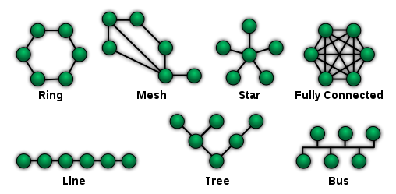
Routing Methods
Mesh
Star
Star + Mesh
Partial Mesh
Picture Source: https://en.wikipedia.org/wiki/Network_topology
Notes:
https://en.wikipedia.org/wiki/Network_topology

Slide 26

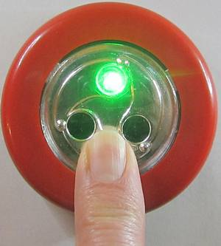
DIY Options
MySensors
https://www.mysensors.org/
Lists: Arduino, ESP8266, Raspberry Pi, NRF24L01+ and RFM69
The Button - a WiFi connected push button
http://benlo.com/esp8266/esp8266Projects.html

Slide 27
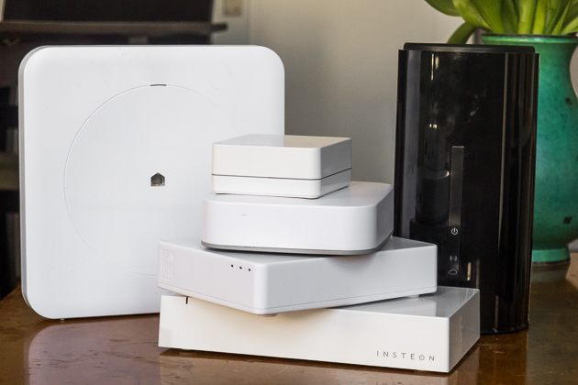
Smartphone Integration
Via Smart Hubs:

Slide 28
Smartphone Integration
Which systems are compatible?
System: | Insteon | Wink Hub | SmartThings Hub | Lowes Iris | WeMo
Technology: | Insteon | WiFi, ZigBee, Z-Wave, Bluetooth LE, Lutron ClearConnect | WiFi, ZigBee, Z-Wave | Z-Wave | WiFi
Open Systems bridge the gaps!
OpenHab
Home Assistant
Domoticz
But watchout! Crossing technology lines may come with a cost: dependency on multiple hubs, additional latency, etc.

Slide 29

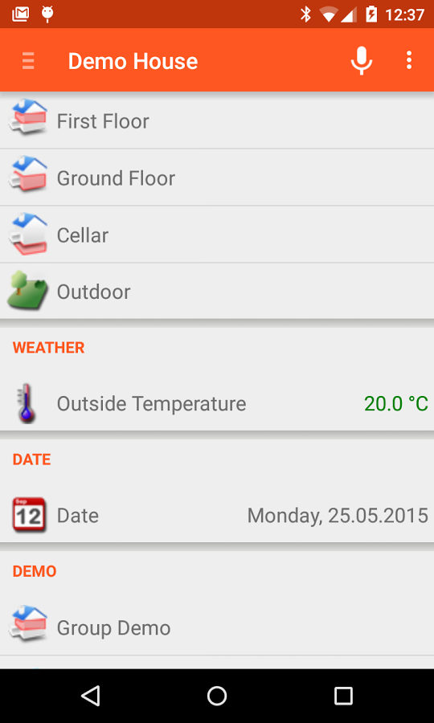
OpenHab
Open source Java
Runs on Windows/ OS X/Linux
Web, Android, iOS Apps
Can download and run in demo mode to see!

Slide 30
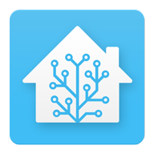
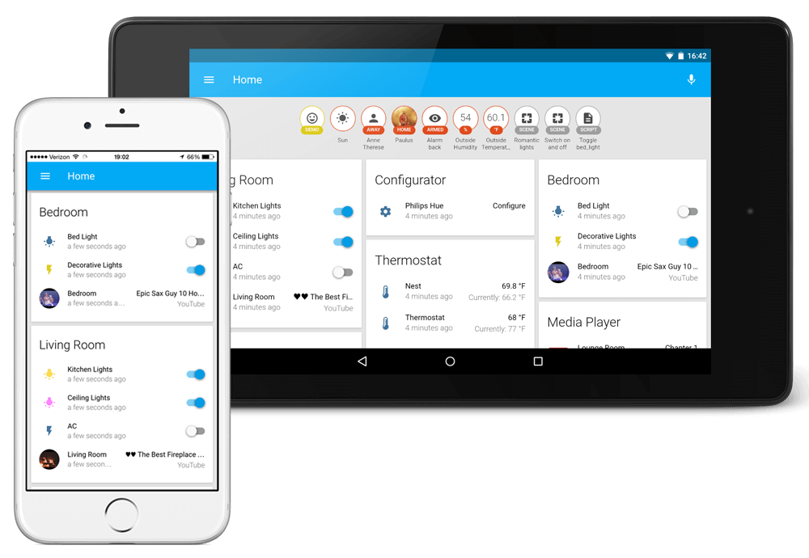
Home Assistant

Slide 31
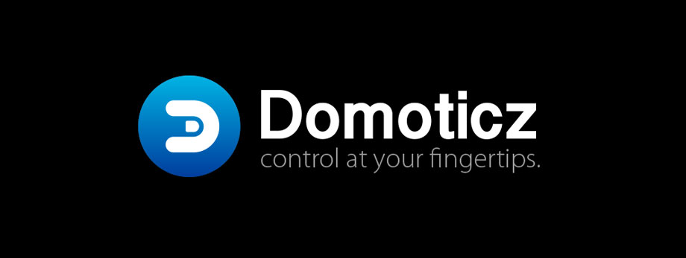
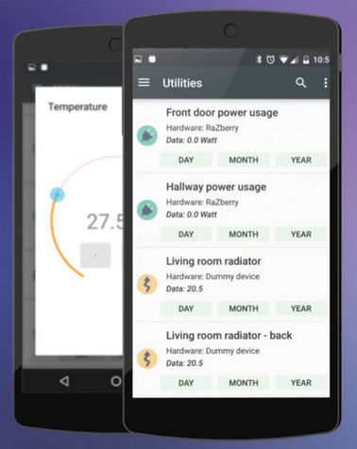
Domoticz
Also Free/ Open Source

Slide 32
OpenHab Example
RaspberryPi as controller
Install Java
Start system
Insteon – 2413U
X10
– cm11a (in development…)
Insteon’s 2413U can also control
Z-Wave option

Slide 33
Limitation of Hard Switches!
X10 – 1 switch, one function
Insteon- 1 switch -> multifunction
(turns on room light + lamps + TV device, etc)
Problem:
Don’t want switch capability to be limited by the switch firmware! (ala Insteon)
Also don’t want switch function to be dependent on central controller!
Solution
Central controller should know what’s what, but, instructions download into each device! (exists?), or:
→ Android touch screens!
(with apps, evolution will occur!)

Slide 34
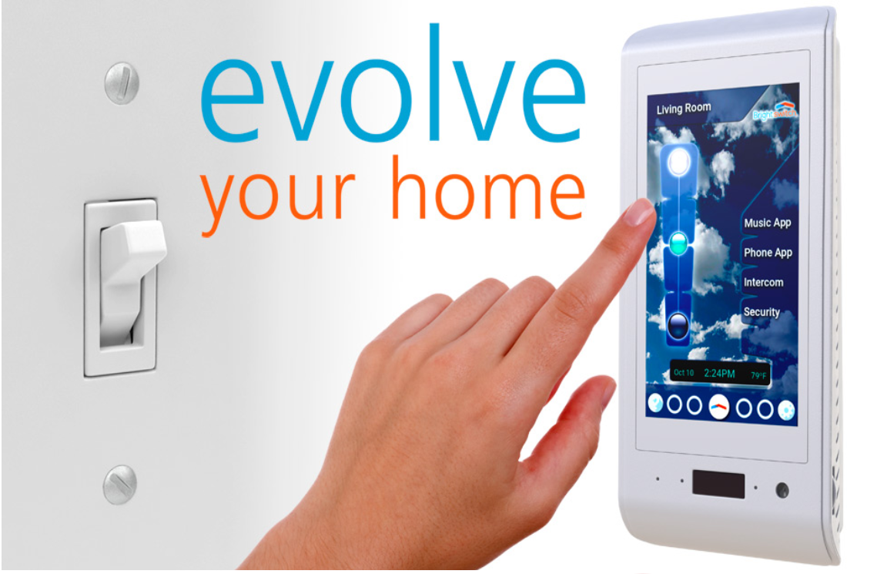
Integration
Brightswitch – Android light switch in development:

Slide 35
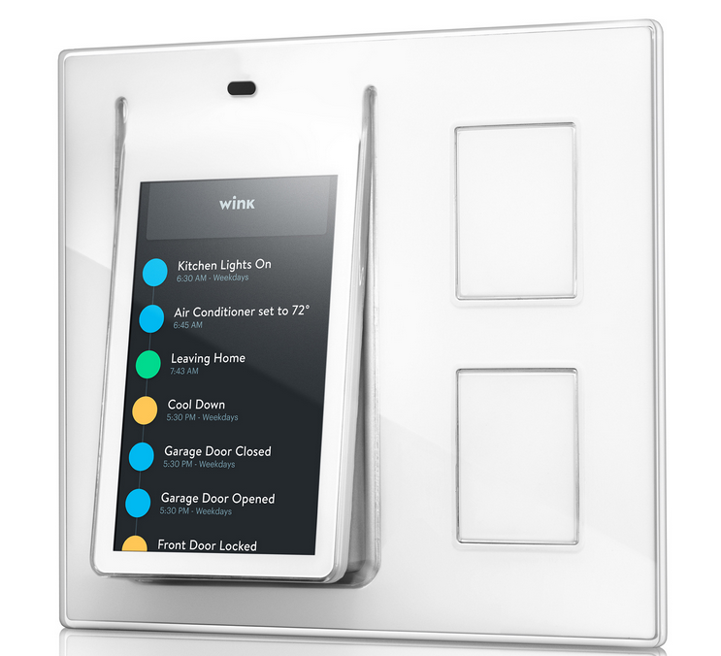
Smartphone Integration
Wink Relay:
Touch screen
control built on Android

Slide 36
Beyond Lights and Outlets…
Voice Control - Alexa and Google Home
Thermostats – Nest, EcoBee, Honeywell
And More:
Sprinkler systems
Locks
Audio/Video Control

Slide 37
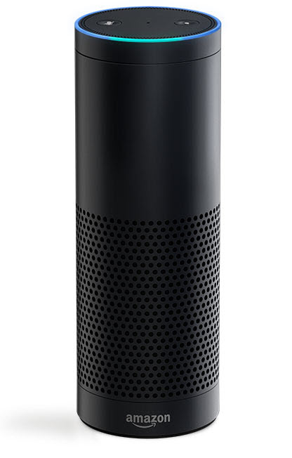
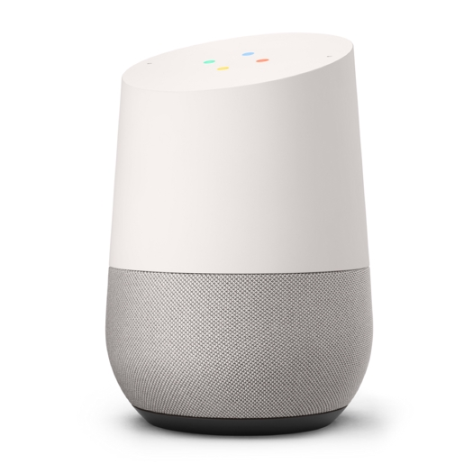
Voice Control
Google Home Assistant
Alexa/Echo from Amazon

Slide 38
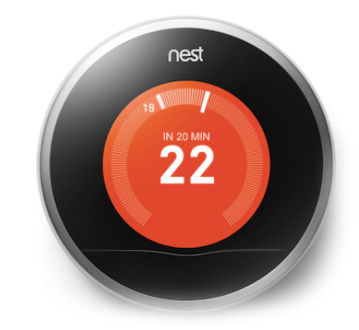
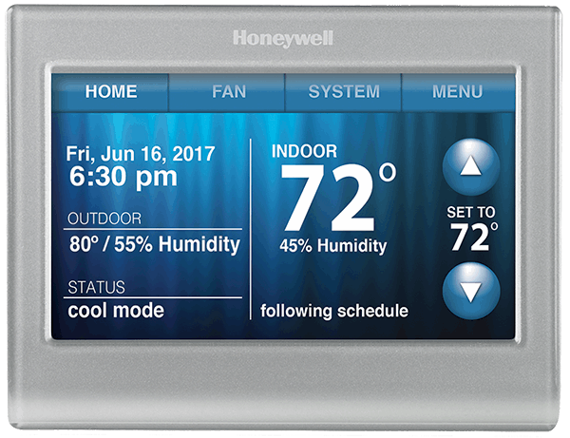
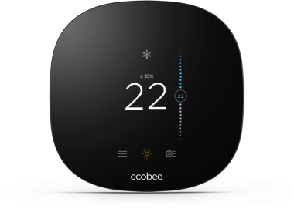
Thermostats
Nest Learning Thermostat
EchoBee
Honeywell (WiFi)

Slide 39
Where to Start ?
Questions
What combinations of the technologies work together, and (TBD) at what additional cost?
X10, Insteon, UPB?
Z-Wave, Zigbee
WiFi
Which technology to use in 2017?
For expanding an existing X10 system, Insteon provides good compatibility.
For new installations, Z-Wave or ZigBee may have a wider selection.

